Slide 1
Multiplex Box-Office Management
Database Management Systems - Final Project
May 11, 2017
Group - 9
Dharmik Bhayani - 201501010
Jaymeen Kachrola - 201501042
Jenil Kansara - 201501044

Slide 2
Description
Movies can have tremendous influence in shaping young lives towards ideals and objectives of normal adult life; we took our project for developing a box office management of a theater.
Our project helps to inquire for movies, details about the movie, and timing of movies and also help book tickets.
The user can look for movies going on in the theater, see how many seats are available in a particular show, what is the price of a movie ticket in different categories, what time is a movie playing, etc.
This project is only for a single movie theater and it can be modified to different theater accordingly to its screens and seats.

Slide 3
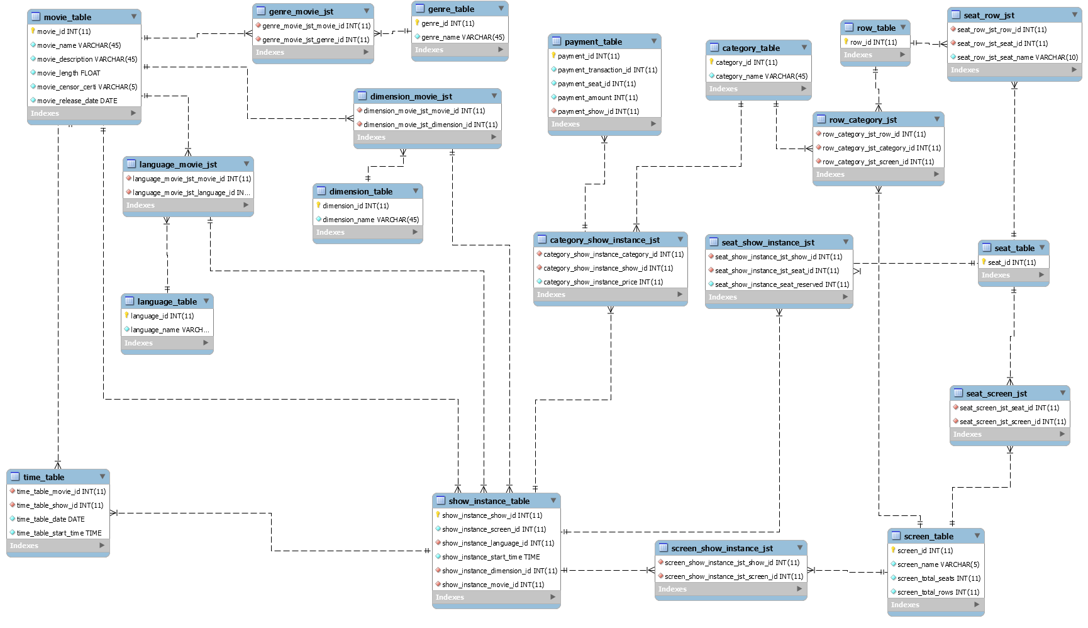
Entity Relation Model

Slide 4
List of Queries
Which movies are playing on a particular date?
SELECT movie_name FROM movie_table WHERE movie_id in (SELECT time_table_movie_id FROM time_table WHERE time_table_date = ‘2017-04- 20’);
Is a particular seat of a particular show available?
SELECT seat_show_instance_seat_reserved FROM seat_show_instance_jst WHERE
seat_show_instance_jst_seat_id in (SELECT seat_row_jst_seat_id FROM seat_row_jst WHERE seat_row_jst_seat_name = ‘A8’) and seat_show_instance_jst_show_id = ‘2’;
What are the 3D/2D movies playing in the theatre?
SELECT movie_name FROM movie_table WHERE movie_id in (SELECT dimension_movie_jst_movie_id FROM dimension_movie_jst WHERE dimension_movie_jst_dimension_id
in(SELECT dimension_id FROM dimension_table WHERE dimension_name = '2D/3D' ));
What are the movies playing of a particular language?
SELECT movie_name FROM movie_table WHERE movie_id in (SELECT language_movie_jst_movie_id FROM language_movie_jst WHERE language_movie_jst_language_id
in(SELECT language_id FROM language_table WHERE language_name = 'Hindi/English' ));
Is a particular seat of a particular show available?
SELECT seat_show_instance_seat_reserved FROM seat_show_instance_jst WHERE
seat_show_instance_jst_seat_id in (SELECT seat_row_jst_seat_id FROM seat_row_jst WHERE seat_row_jst_seat_name = ‘A8’ and seat_show_instance_jst_show_id = ‘2’ ;

Slide 5
List of Queries
● What are the movies currently playing of a particular genre?
SELECT movie_name FROM movie_table WHERE movie_id in (SELECT genre_movie_jst_movie_id FROM genre_movie_jst WHERE genre_movie_jst_genre_id
in(SELECT genre_id FROM genre_table WHERE genre_name = 'Thriller' ));
● What are the movies releasing soon?
SELECT movie_name FROM movie_table WHERE movie_release_date > '2017-04-20';
● What is the start time of the movie of a show with the show_id=x?
SELECT show_instance_start_time FROM show_instance_table WHERE show_instance_show_id = '2';
● What is the screen number of the movie of a show with the show_id=x?
SELECT screen_name FROM screen_table WHERE screen_id in (SELECT show_instance_screen_id FROM show_instance_table WHERE show_instance_show_id = '1');
● What is the language of the movie of a show with the show_id=x?
SELECT language_name FROM language_table WHERE language_id in (SELECT show_instance_language_id FROM show_instance_table WHERE show_instance_show_id = '1');
● What is the price of movie ticket at a particular time?
SELECT category_table.category_name, category_show_instance_jst.category_show_instance_price, category_show_instance_jst.category_show_instance_show_id FROM category_show_instance_jst INNER JOIN category_table ON category_show_instance_jst.category_show_instance_show_id = '1'AND category_show_instance_jst.category_show_instance_category_id = category_table.category_id;

Slide 6
List of Queries
● Which movies are starting at a particular time?
SELECT show_instance_table.show_instance_show_id , category_table.category_name , category_show_instance_jst.category_show_instance_price
FROM ((category_show_instance_jst INNER JOIN category_table ON category_show_instance_jst. category_show_instance_category_id = category_table.category_id) INNER JOIN show_instance_table ON show_instance_table.show_instance_show_id = category_show_instance_jst. Category_show_instance_show_id AND show_instance_table.show_instance_start_time = '09:00:00');
● How many seats a particular screen has?
SELECT screen_total_seats FROM screen_table WHERE screen_id = '2';
● How many rows a particular screen has?
SELECT screen_total_rows FROM screen_table WHERE screen_id = '1';
● In a screen, which rows are of which category?
SELECT category_table.category_name, row_category_jst.row_category_jst_row_id
FROM row_category_jst INNER JOIN category_table ON row_category_jst.row_category_jst_screen_id = '1'
AND row_category_jst.row_category_jst_category_id = category_table.category_id;
● In a screen, which rows are of which category?
SELECT category_table.category_name, row_category_jst.row_category_jst_row_id
FROM row_category_jst INNER JOIN category_table ON row_category_jst.row_category_jst_screen_id = '1'
AND row_category_jst.row_category_jst_category_id = category_table.category_id
AND category_table.category_name = 'GOLD';

Slide 7
List of Queries
● What is the price of GOLD(or any category) category of a show?
SELECT category_table.category_name, category_show_instance_jst.category_show_instance_price, category_show_instance_jst.category_show_instance_show_id FROM category_show_instance_jst
INNER JOIN category_table ON category_show_instance_jst.category_show_instance_show_id = '1' AND category_show_instance_jst.category_show_instance_category_id = category_table.category_id AND category_table.category_name = 'GOLD';
● What is the price of movie ticket of a given show id?
SELECT category_table.category_name, category_show_instance_jst.category_show_instance_price,category_show_instance_jst.category_show_instance_show_id FROM category_show_instance_jst INNER JOIN category_table ON category_show_instance_jst.category_show_instance_show_id = '1'AND category_show_instance_jst.category_show_instance_category_id = category_table.category_id;
● What is the price of movie ticket of all the shows in a day?
SELECT category_table.category_name, category_show_instance_jst.category_show_instance_price, category_show_instance_jst.category_show_instance_show_id FROM category_show_instance_jst INNER JOIN category_table ON category_show_instance_jst.category_show_instance_category_id = category_table.category_id;
● Is a particular movie available in 3D/2D?
SELECT movie_table.movie_name ,dimension_movie_jst.dimension_movie_jst_movie_id dimension_table.dimension_name FROM ((dimension_movie_jst INNER JOIN movie_table ON movie_table.movie_id =
dimension_movie_jst.dimension_movie_jst_movie_id) INNER JOIN dimension_table ON dimension_table.dimension_id
Dimension_movie_jst.dimension_movie_jst_dimension_id AND movie_table.movie_name = ‘Baahubali 2’
AND dimension_table.dimension_name = ‘3D’);

Slide 8
Stored Procedures
To insert movie details
delimiter //
create procedure insert_genre_movie_jst(in movie_id int(11) , in genre_name varchar(45))
begin
declare genre_id_var int(11);
select genre_id into genre_id_var from genre_table where genre_table.genre_name = genre_name;
insert into genre_movie_jst (genre_movie_jst_movie_id , genre_movie_jst_genre_id) values (movie_id , genre_id_var);
end //
delimiter //
create procedure insert_language_1(in movie_id int(11) , in language_name_1 varchar(45))
begin
declare language_id_var int(11);
select language_id into language_id_var from language_table where language_table.language_name = language_name_1;
insert into language_movie_jst values (movie_id , language_id_var);
end //
delimiter //
create procedure insert_language_2(in movie_id int(11) , in language_name_1 varchar(45) , in language_2 varchar(45))
begin
declare language_id_var int(11);
select language_id into language_id_var from language_table where language_table.language_name = language_name_1;
insert into language_movie_jst (language_movie_jst_movie_id , language_movie_jst_language_id) values (movie_id , language_id_var);

Slide 9
select language_id into language_id_var from language_table where language_table.language_name = language_name_2;
insert into language_movie_jst (language_movie_jst_movie_id , language_movie_jst_language_id) values (movie_id , language_id_var);
end //
delimiter //
create procedure insert_language_3(in movie_id int(11) , in language_name_1 varchar(45) , in language_name_2 varchar(45) , in language_3 varchar(45))
begin
declare language_id_var int(11);
select language_id into language_id_var from language_table where language_table.language_name = language_name_1;
insert into language_movie_jst (language_movie_jst_movie_id , language_movie_jst_language_id) values (movie_id , language_id_var);
select language_id into language_id_var from language_table where language_table.language_name = language_name_2;
insert into language_movie_jst (language_movie_jst_movie_id , language_movie_jst_language_id) values (movie_id , language_id_var);
select language_id into language_id_var from language_table where language_table.language_name = language_name_3;
insert into language_movie_jst (language_movie_jst_movie_id , language_movie_jst_language_id) values (movie_id , language_id_var);
end //
delimiter //
create procedure insert_dimension_1(in movie_id int(11) , in dimension_name_1 varchar(45))
begin
declare dimension_id_var int(11);
select dimension_id into dimension_id_var from dimension_table where dimension_table.dimension_name = dimension_name_1;
insert into dimension_movie_jst (dimension_movie_jst_movie_id , dimension_movie_jst_dimension_id) values (movie_id , dimension_id_var);
end //
delimiter //

Slide 10
create procedure insert_dimension_2(in movie_id int(11) , in dimension_name_1 varchar(45) , in dimension_name_2 varchar(45))
begin
declare dimension_id_var int(11);
select dimension_id into dimension_id_var from dimension_table where dimension_table.dimension_name = dimension_name_1;
insert into dimension_movie_jst (dimension_movie_jst_movie_id , dimension_movie_jst_dimension_id) values (movie_id , dimension_id_var);
select dimension_id into dimension_id_var from dimension_table where dimension_table.dimension_name = dimension_name_2;
insert into dimension_movie_jst (dimension_movie_jst_movie_id , dimension_movie_jst_dimension_id) values (movie_id , dimension_id_var);
end //
delimiter //
create procedure insert_movies(in movie_name varchar(45) , in movie_description varchar(45) , in movie_length float , in movie_censor_certi varchar(45) , in movie_release_date date , in language_sequence varchar(10) , in dimension_sequence char(2) , in genre_name varchar(45))
begin
declare movie_id_var int(11);
insert into movie_table (movie_name , movie_description , movie_length , movie_censor_certi , movie_release_date) values (movie_name , movie_description , movie_length , movie_censor_certi , movie_release_date);
select movie_id into movie_id_var from movie_table where movie_table.movie_name = movie_name;
call insert_genre_movie_jst(movie_id_var , genre_name);
case
when (language_sequence = '001')
then call insert_language_1(movie_id_var , 'Tamil');

Slide 11
when (language_sequence = '010')
then call insert_language_1(movie_id_var , 'English');
when (language_sequence = '011')
then call insert_language_2(movie_id_var , 'English' , 'Tamil');
when (language_sequence = '100')
then call insert_language_1(movie_id_var , 'Hindi');
when (language_sequence = '101')
then call insert_language_2(movie_id_var , 'Hindi' , 'Tamil');
when (language_sequence = '110')
then call insert_language_2(movie_id_var , 'Hindi' , 'English');
when (language_sequence = '111')
then call insert_language_3(movie_id_var , 'Hindi' , 'English' , 'Tamil');
end case;
case
when (dimension_sequence = '11')
then call insert_dimension_2(movie_id_var , '2D' , '3D');
when (dimension_sequence = '10')
then call insert_dimension_1(movie_id_var , '2D');
end case;
end //
delimiter ;

Slide 12
Stored Procedures
To insert a new show in time table
DELIMITER $$
CREATE PROCEDURE complete_time_table(IN show_id INT(11), screen_id INT(11), language_id INT(11), start_time TIME, dimension_id INT(11), movie_id INT(11), date_insert DATE)
BEGIN
INSERT INTO show_instance_table VALUES (show_id , screen_id , language_id , start_time , dimension_id , movie_id);
INSERT INTO time_table VALUES (movie_id, show_id,date_insert, start_time);
END $$
DELIMITER ;
call complete_time_table (19,1,1,'09:00:00',1,2,'2017-04-21');
To insert price details of different shows
DELIMITER $$
CREATE PROCEDURE set_price (IN show_id INT(11), gold_price INT(11), silver_price INT(11), bronze_price INT(11))
BEGIN
INSERT INTO category_show_instance_jst VALUES (1, show_id, gold_price);
INSERT INTO category_show_instance_jst VALUES (2, show_id, silver_price);
INSERT INTO category_show_instance_jst VALUES (3, show_id, bronze_price);
END $$
DELIMITER ;

Slide 13
Stored Procedures
To insert payment details of 1 seat booking
DELIMITER $$
CREATE PROCEDURE payment (IN payment_id INT(11), transaction_id INT(11), seat_id INT(11),show_id INT(11))
BEGIN
DECLARE total_amount INT(11);
SELECT category_show_instance_price INTO total_amount FROM category_show_instance_jst WHERE category_show_instance_category_id IN (SELECT row_category_jst_row_id FROM row_category_jst WHERE row_category_jst_row_id IN (SELECT seat_row_jst_row_id FROM seat_row_jst WHERE seat_row_jst_seat_id = seat_id)) AND category_show_instance_jst.category_show_instance_show_id = show_id;
INSERT INTO payment_table VALUES (payment_id,transaction_id, seat_id, 100, show_id);
UPDATE `theatre`.`seat_show_instance_jst` SET `seat_show_instance_seat_reserved`='1' WHERE `seat_show_instance_jst_show_id`= show_id AND `seat_show_instance_jst_seat_id` = seat_id;
END $$
DELIMITER ;
call payment(2,1002,2,1);

Slide 14
Conclusion
With MySQL, the database is designed to support different types of functionalities for a movie theater box office management including operations on the movie list, timetable, setting ticket prices and selling of a ticket.
Thus providing a clear and complete solution for a front-end to work upon.

Slide 15
Thank You

